Slide 1
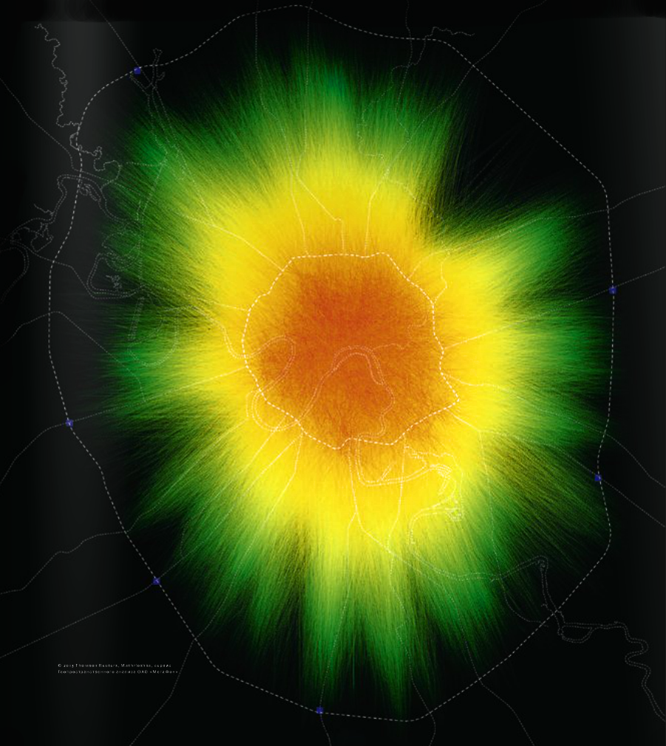
Research of mobile phone subscribers routes
February, 2015

Slide 2
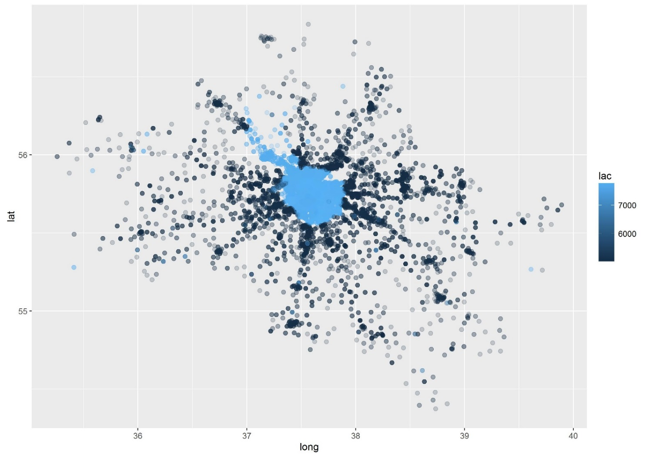
Research objectives and input data
Task
Objective of the research was to build a classifier which would analyze path data gathered from telecom base stations around Moscow and would identify all ‘msisdns’ that belongs to a particular user with the high probability. Purpose of this research is to build a database with user id and corresponding matching ‘msisdns’.
Input data:
Sample with matching ‘msisdns’ – phone numbers that belong to the same users – train data
Database with the ‘msisdns’ and time of the user registration on the base stations during the day – path data
“imei – phone type” matching table
Dictionary with base station “event type” field description
Sample data provided for 23rd – 25th of May 2013

Slide 3
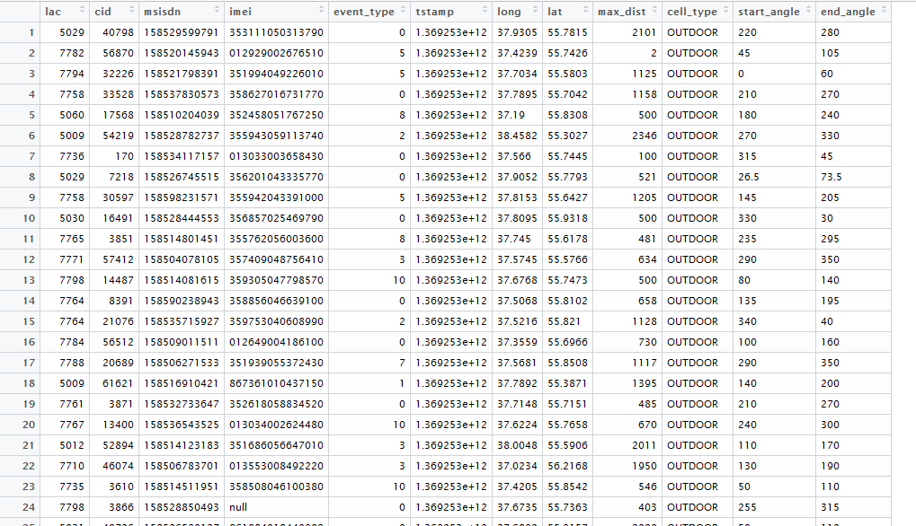
Base station registration data
Data consist of the following fields:
Lac and cid are base stations group_id and station_id correspondingly
msisdn – unique identifier of a user
Imei – identifier of the user phone
Event_type – type of the signal registered on the base station (type of the event)
Tstamp – time of the registered event
Long/lat/ max_dist/start_angle/end_angle parameters of the base station and its coverage area
Cell_type – type of the base station

Slide 4
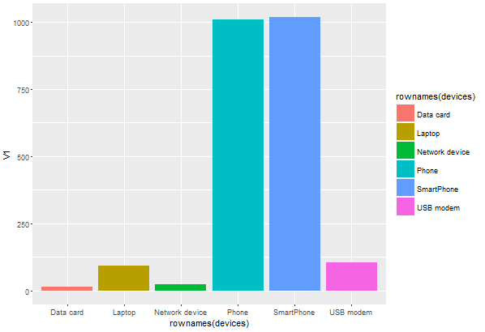
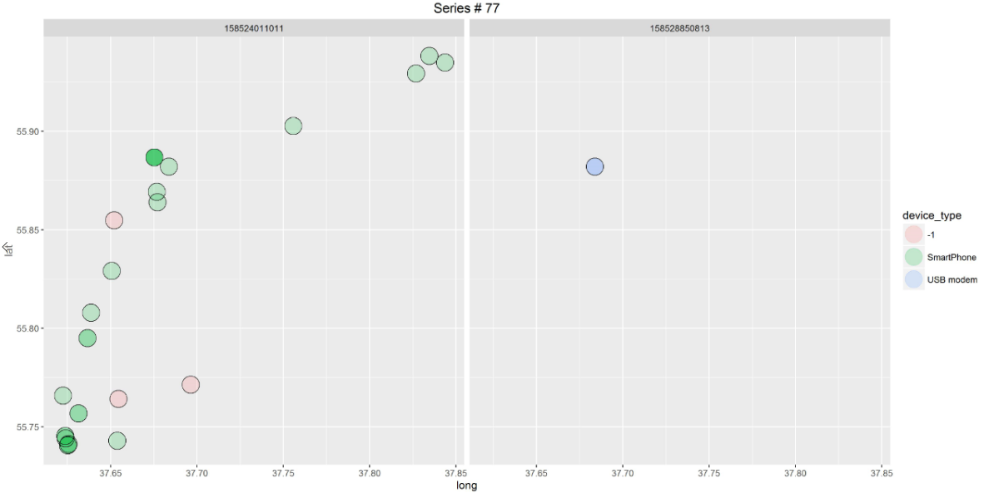
Visual analysis: phone distribution
Visual analyze shows that some of the data is generated by laptop’s and modems
Data generated by laptops and usb modems usually have less data points (points corresponding to ‘msisdn’) vs phone data
All phones are divided into two groups “Phones” and “Smartphones”, later analysis suggests that same device can be attributed to both groups (e.g same device have both descriptions “Apple – iOs – phone” and “Apple – iOs – Smartphone”). This observation lead to merging together “Phone” and “Smartphone” groups.

Slide 5
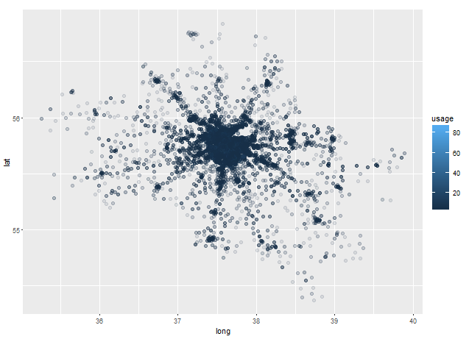
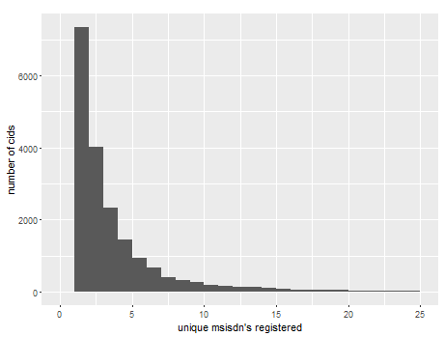
Visual analysis: number of unique ‘msisdns’ for each base station
Data provided for 18891 different base stations
We will define base station usage as number of unique ‘msidns’ registered in this base station
Data shows that most of the base stations were visited by less than five different ‘msisdns’
About 40% of all base stations were visited only by one ‘msisdn’

Slide 6
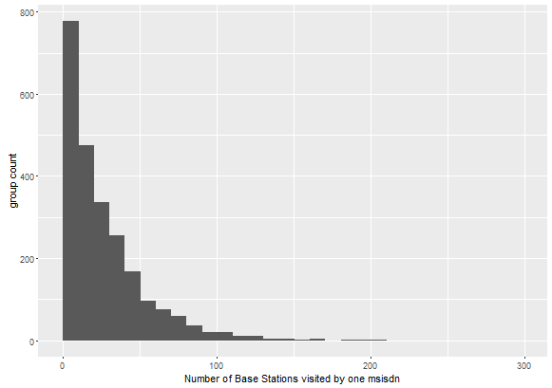
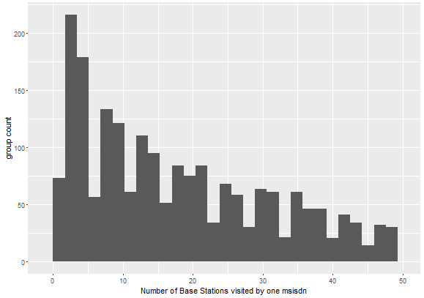
Visual analysis: distribution of number of points in msisdn path

Slide 7
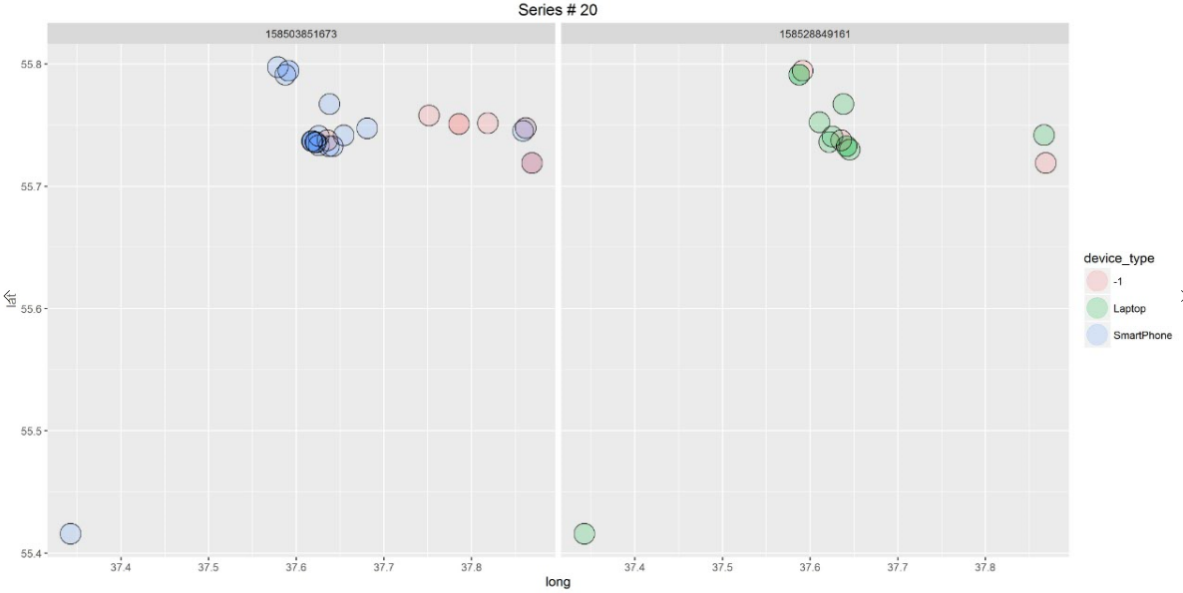
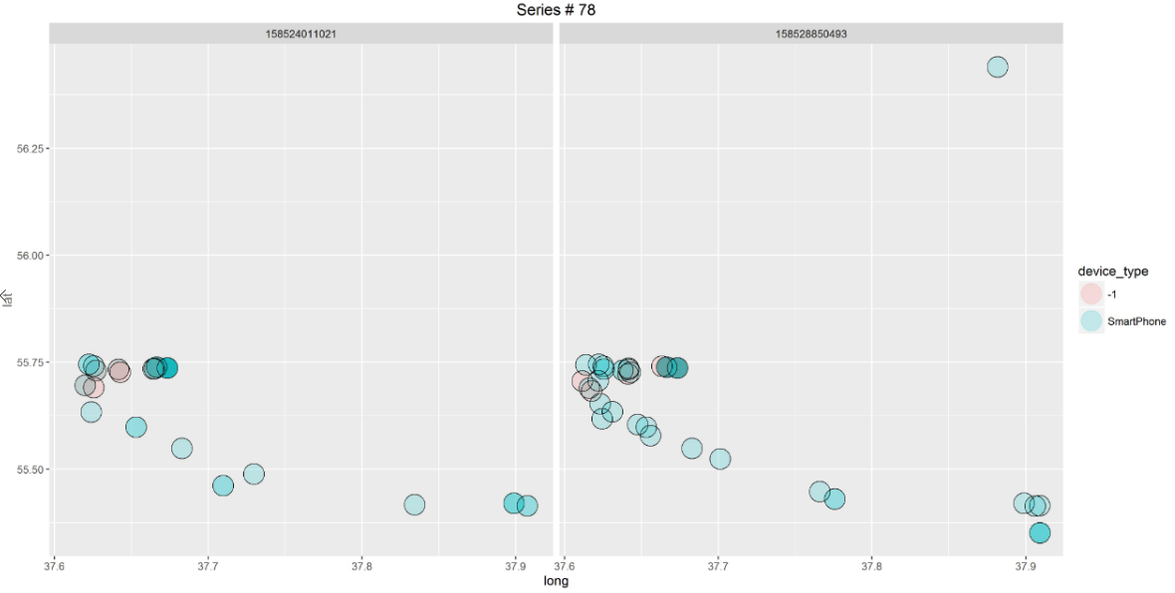
Visual analysis: Fact table
From the fact table we can see that two ‘msisdns’ match if they’ve visited at least several same base stations
We can measure this similarities using several metrics: Jaccard Index, Bernstein and Zobel S2 and S3 similarities measures, number of same base stations visited, number of unique base stations in every path

Slide 8
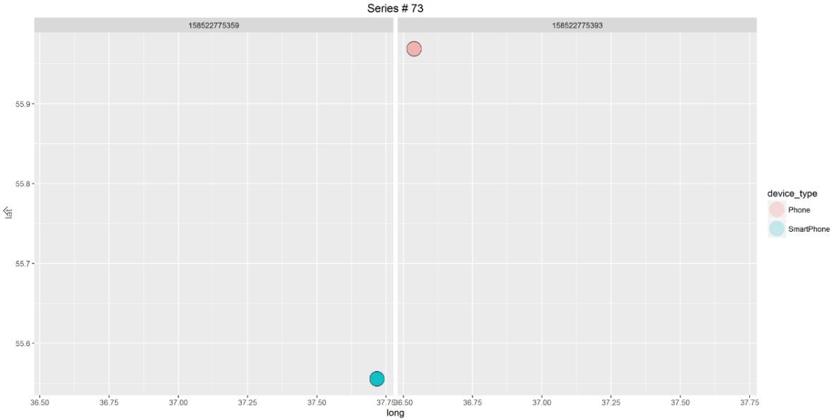
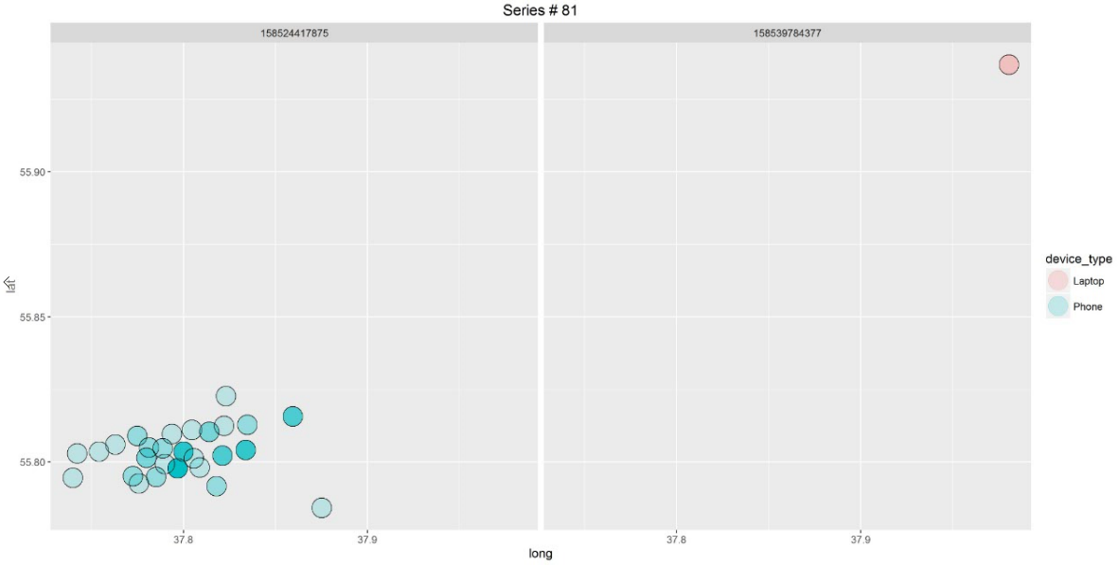
Visual analysis: Fact table
Some msisdn’s that are assumed to be matched in the fact table visually doesn’t have any base stations in common
Geographically this ‘msisdns’ can be far away from each other and can be easily separated by line
This stations could be outliers and its under discussion if they need to be removed from dataset

Slide 9
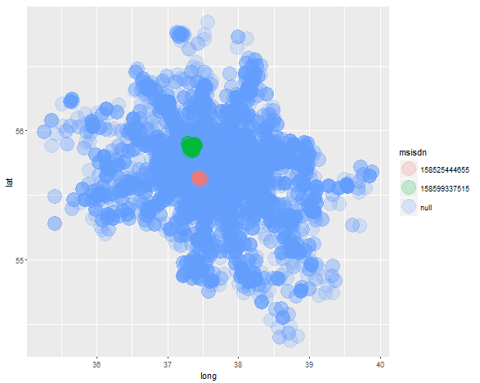
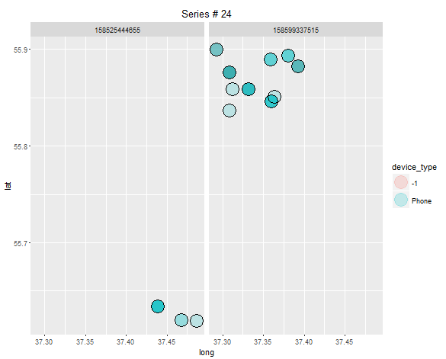
Visual analysis: Fact table
This two ‘msisdns’ are assumed to belong to the same user
However we can visually see on the map that they don’t have any geo data in common and located in different Moscow parts

Slide 10
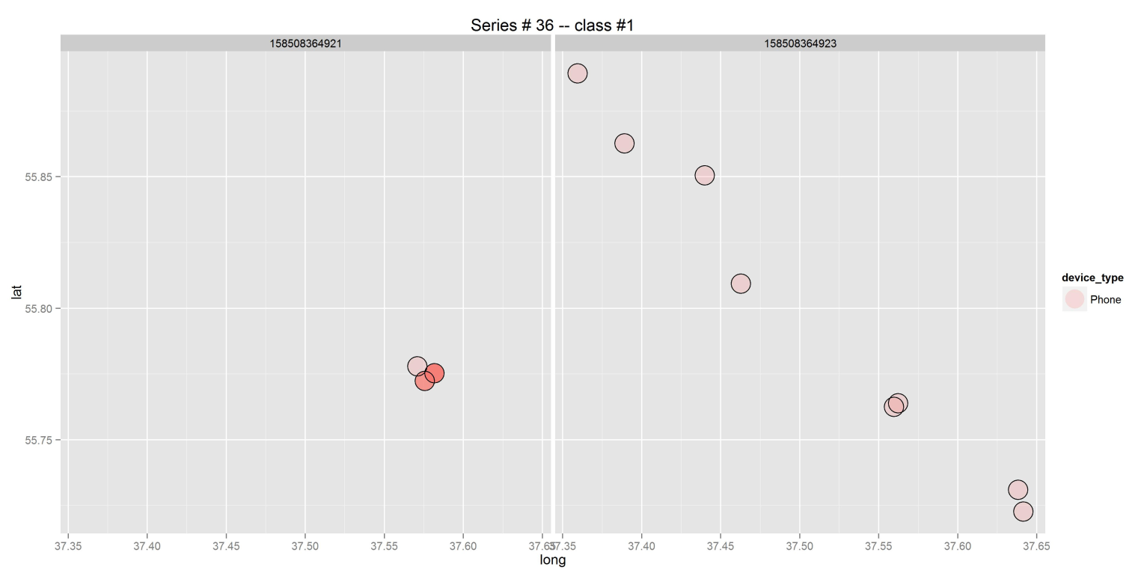
Visual analysis: Fact table
On the other hand we can see examples in the fact table were two ‘msisdn’s’ are matched with each other, but one of the matched msisdn’s have less than 4 points and this points displaced from the track produced by the second ‘msisdn’
Jaccard distance won’t work in this cases
My approach would be to take all ‘msisdn’s’ with short tracks (less or equal 3 points) and add to each point of their track all nearest base stations – base stations that have overlapping signals with points from the original track (see next slides)

Slide 11
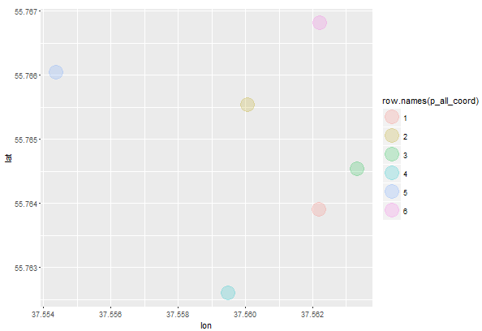
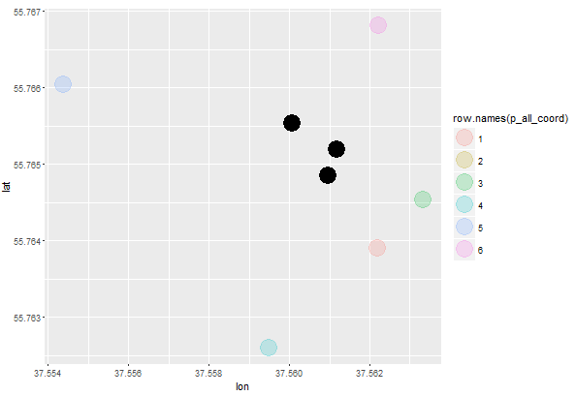
Example of the result from the algorithm that calculate base stations overlapping points
Two base stations have overlapping signals
Searching for overlapping area

Slide 12
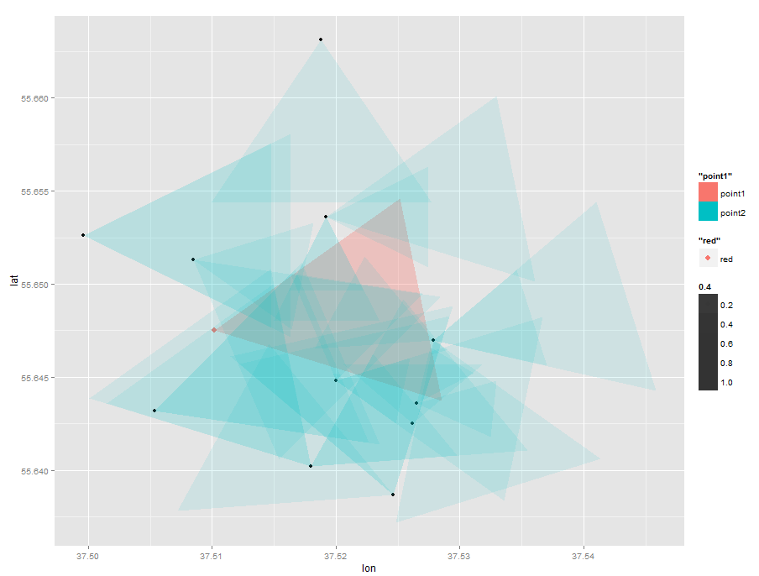
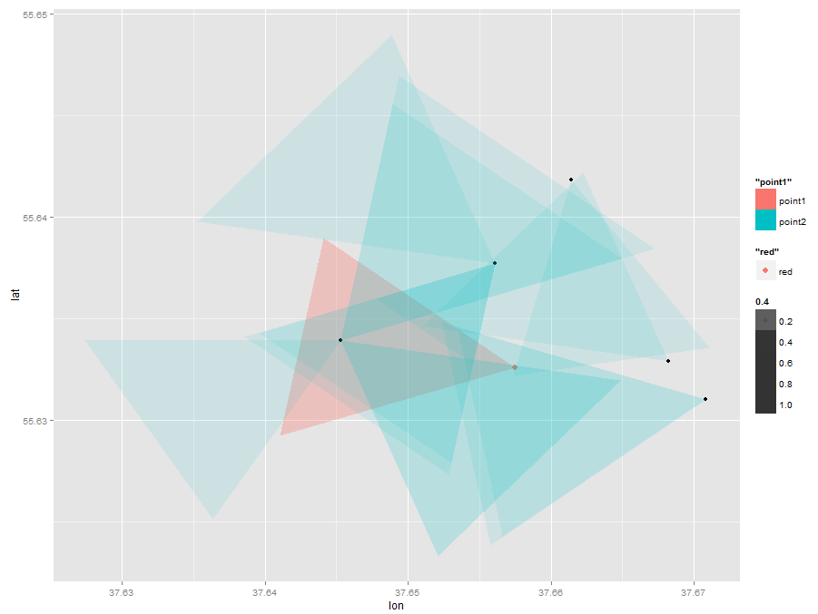
Example of set of base stations that overlaps a selected station
On the graphs we can see a red triangle – this is a working zone of the selected base station
To calculate all overlapping stations we use the following algorithm:
Search for all stations in a reasonable radius from the selected stations
For each of the station in this radius we identify if stations have overlapping connection zones with current station or not

Slide 13
Buildling train and test datasets
Test data:
Will contain of 120 matched pairs from the fact table with class label ‘1’ – e.g. two pairs match
1100 pairs generated from other combinations of the ‘msisdn’s’ available in the fact table. We will assume that with the high probability this ‘msisdn’s’ don’t match. This pairs will have class ‘0’ (This fact was visually verified)
Total 1220 observations
Test data:
Input data have 2361 different ‘msisdn’s’
To build the test data we will construct the matrix with all possible unique combinations of this 2361 ids e.g test data will consist of pairs of ‘msisdn’s’. Then we will use classifier to predict if two ‘msisdn’s’ match with each other or not.

Slide 14
Building Features
Number of matching points, number of non-matched points of track1, numbed of non-matched points in track2, total number of non-matched points
Jaccard distance, S2 and S3 distances between two ‘msisdn’s’ tracks
If two ‘msisdn’s’ have matching phones
If two ‘msisdn’s’ have matching phone vendors
If one of two ‘msisdn’s’ used Laptop, USB modem or other Network device
Jaccard distance, S2 and S3 distances for the adjusted data with nearest base stations added to the ‘msisdn’s’ witch have less or equal than three unique points
Number of matching and non matching bases stations in track for adjusted data

Slide 15
Model
The classifier was build with the Logistic regression model
Features selection was made using RFECV with logistic regression
Model was tested using 5-folds stratified cross validation
Parameters tuning using 5-folds CV: C-value
Features were build and model was trained on the AWS ‘c3.8xlarge’ instance
Model accuracy score on training data is 78%

Slide 16
Building final phone matching table
Logistic regression return class (matched/non-matched) and the similarity probability for each of the tracks in test set
Before continuing working with this data we need to make some assumptions:
Model shows many similar tracks to each ‘msisdn’. We will focus only on the most probable – that have probability 0.95 and higher
Each ‘msisdn’ can’t have more than 3 different matches, because it’s unlikely that person have more than 3 phone numbers.
Final table with matched routes will be constructed based on the described rules.

Slide 17
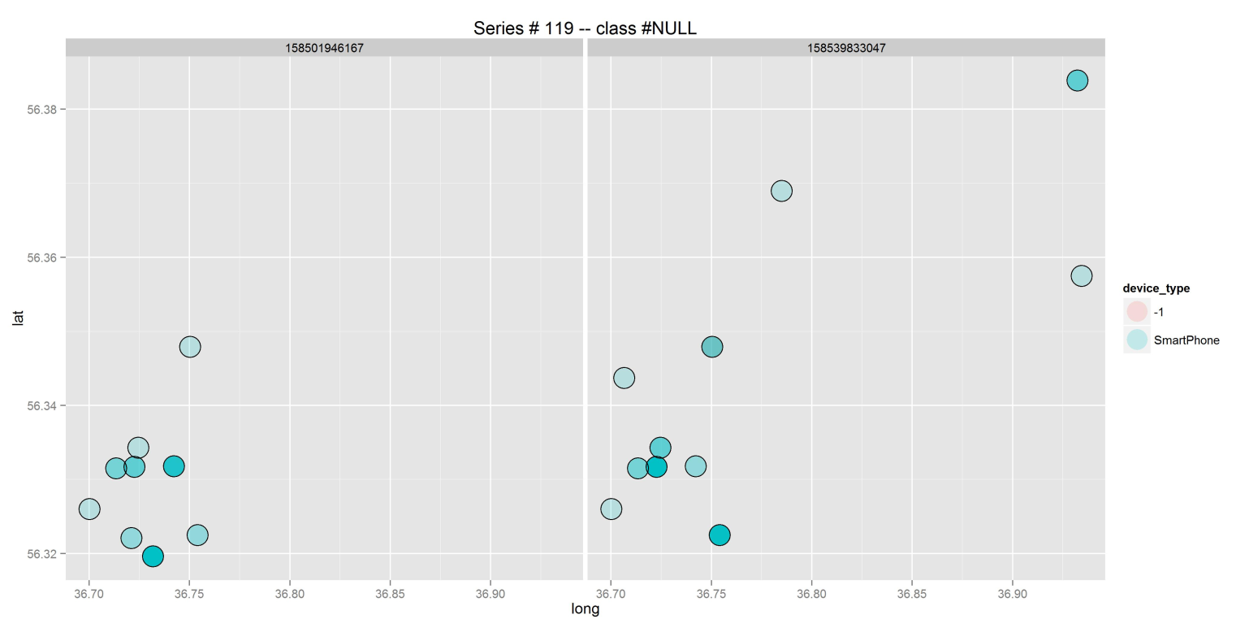
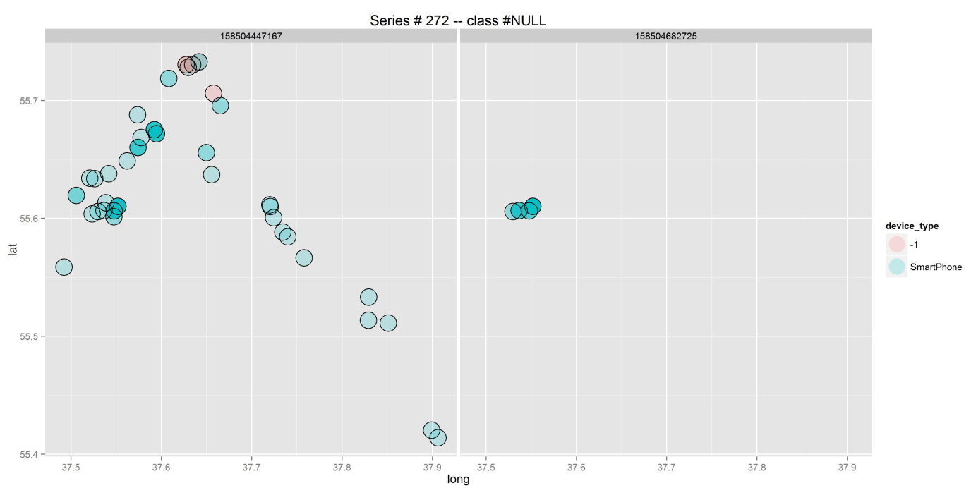
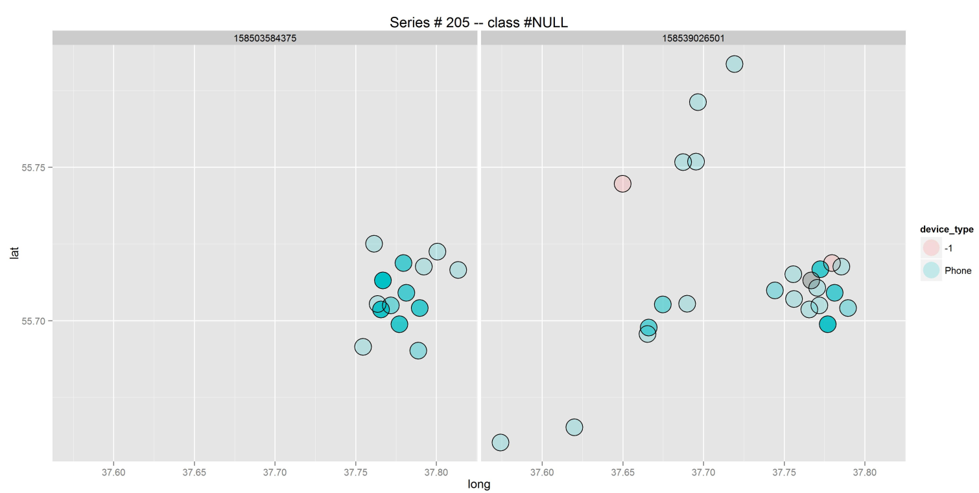
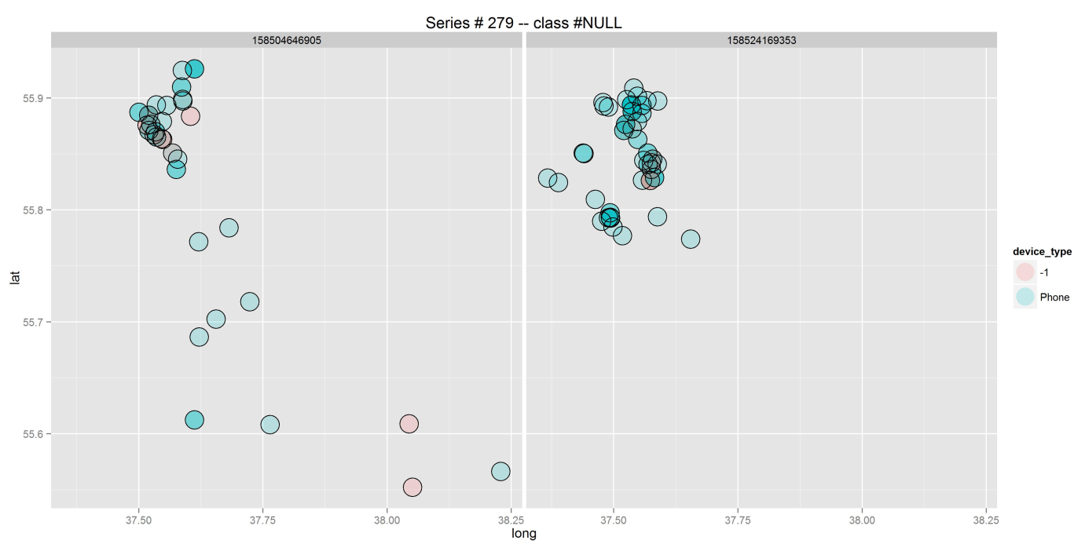
Example of produced matching pairs

Slide 18
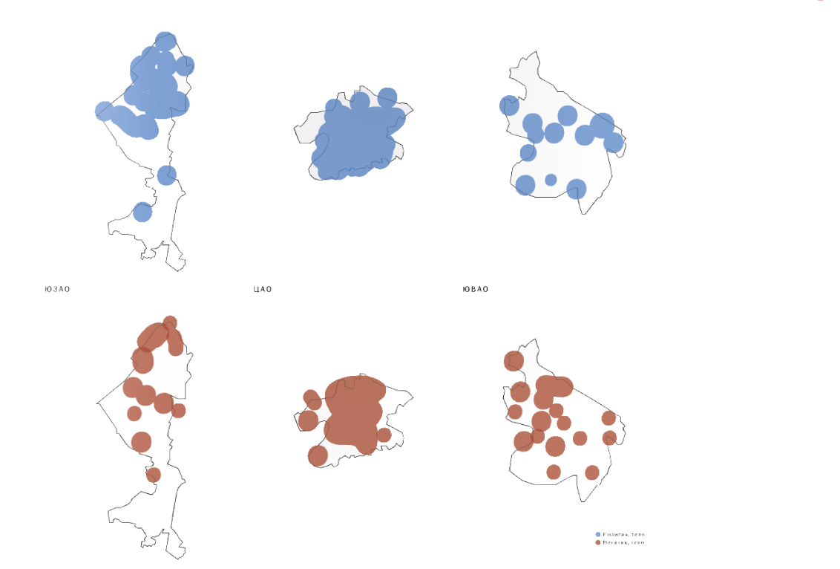
Fin.

